Slide 1

Housing Project
By: Shruti gamne

Slide 2
INTRODUCTION
House price prediction can help the developer determine the selling price of a house and can help the customer to arrange the right time to purchase a house. There are three factors that influence the price of a house which include physical conditions, concept and location.
House price forecasting is an important topic of real estate. The literature attempts to derive useful knowledge from historical data of property markets. Machine learning techniques are applied to analyse historical property transactions to discover useful models for house buyers and sellers. Revealed is the high discrepancy between house prices in the most expensive and most affordable suburbs. Moreover, experiments demonstrate that the Multiple Linear Regression that is based on mean squared error measurement is a competitive approach.to maintain the transparency among customers and also the comparison can be made easy through this model. If customer finds the price of house at some given website higher than the price predicted by the model, so he can reject that house.

Slide 3
Problem Statement
Houses are one of the necessary need of each and every person around the globe and therefore housing and real estate market is one of the markets which is one of the major contributors in the world’s economy. It is a very large market and there are various companies working in the domain. Data science comes as a very important tool to solve problems in the domain to help the companies increase their overall revenue, profits, improving their marketing strategies and focusing on changing trends in house sales and purchases. Predictive modelling, Market mix modelling, recommendation systems are some of the machine learning techniques used for achieving the business goals for housing companies. Our problem is related to one such housing company. A US-based housing company named Surprise Housing has decided to enter the Australian market. The company uses data analytics to purchase houses at a price below their actual values and flip them at a higher price. For the same purpose, the company has collected a data set from the sale of houses in Australia. The data is provided in the CSV file below. The company is looking at prospective properties to buy houses to enter the market. You are required to build a model using Machine Learning in order to predict the actual value of the prospective properties and decide whether to invest in them or not.
For this company wants to know:
• Which variables are important to predict the price of variable?
• How do these variables describe the price of the house?

Slide 4
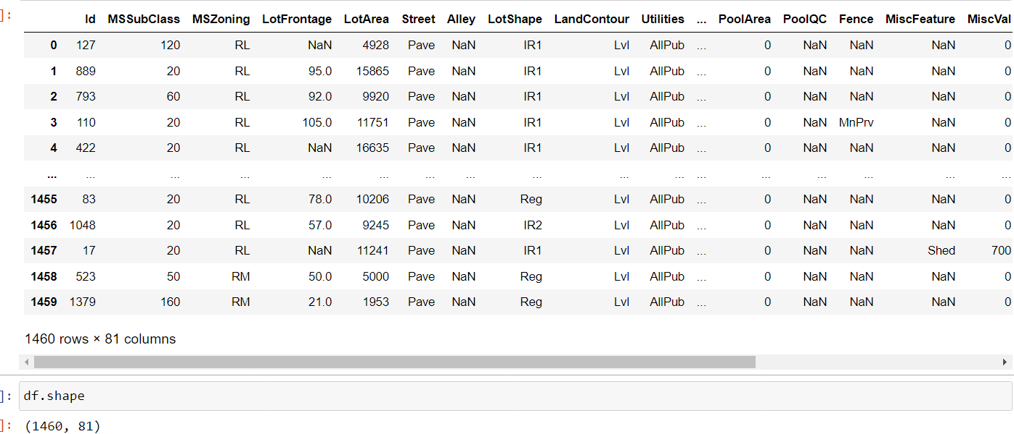
DATASET Housing dataset(1460 rows,81 columns)

Slide 5
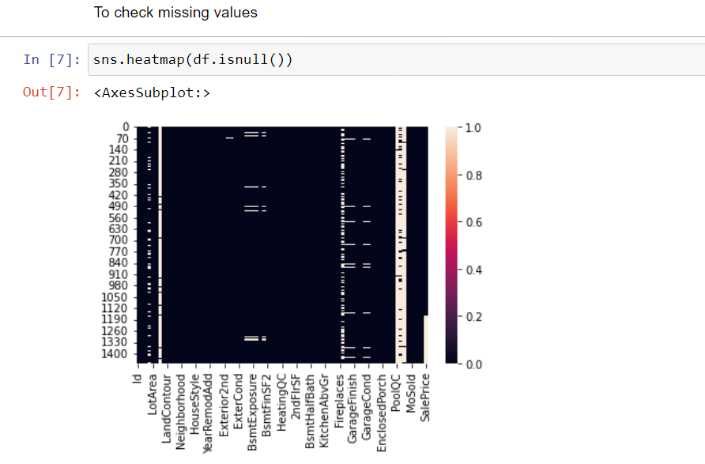
Checking missing/null values

Slide 6
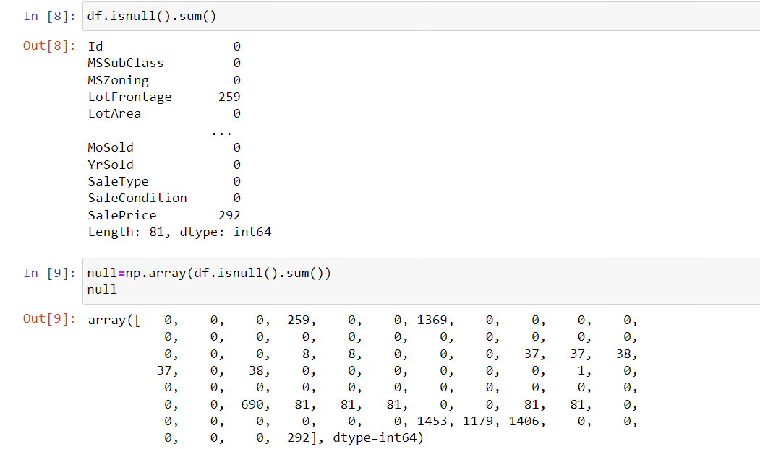

Slide 7
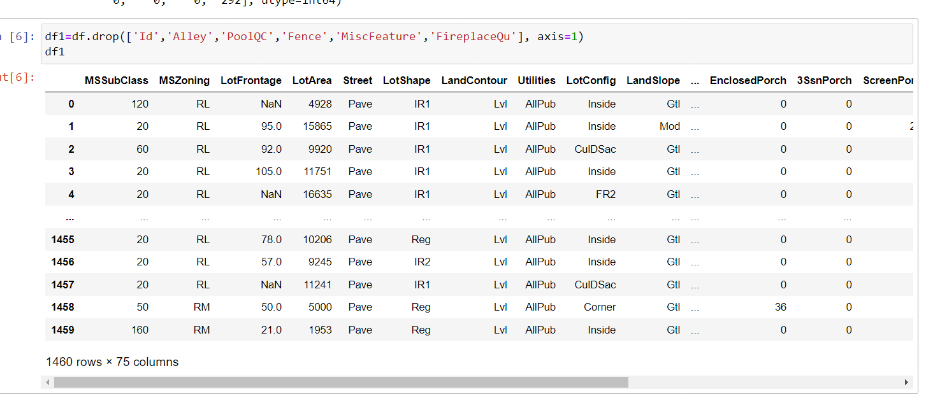
Dropping of columns

Slide 8
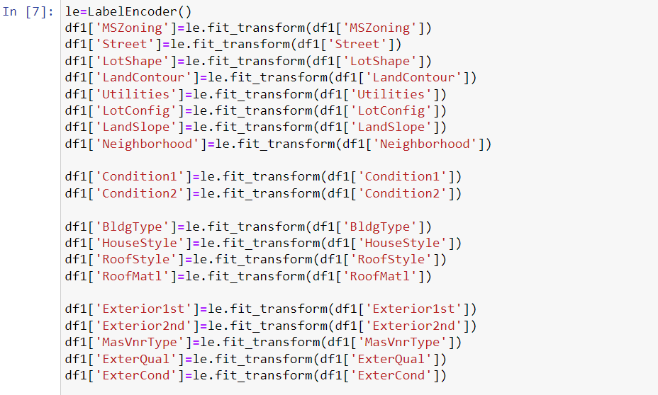
Encoding string/categorical values

Slide 9
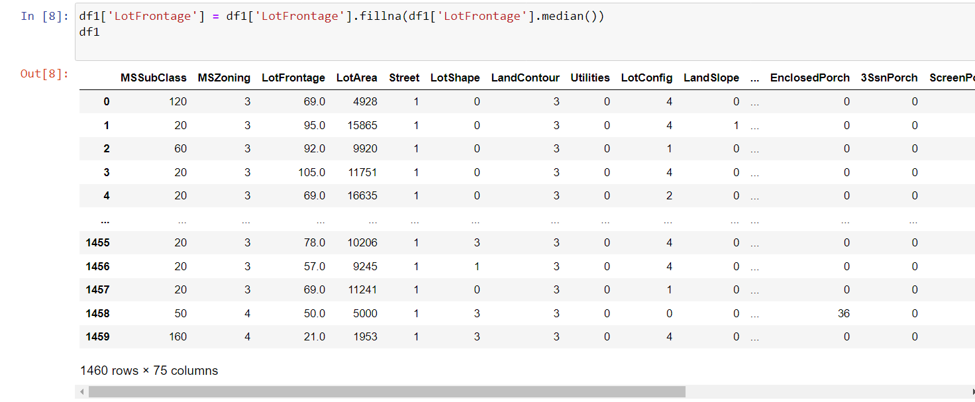
Filling null values with median

Slide 10
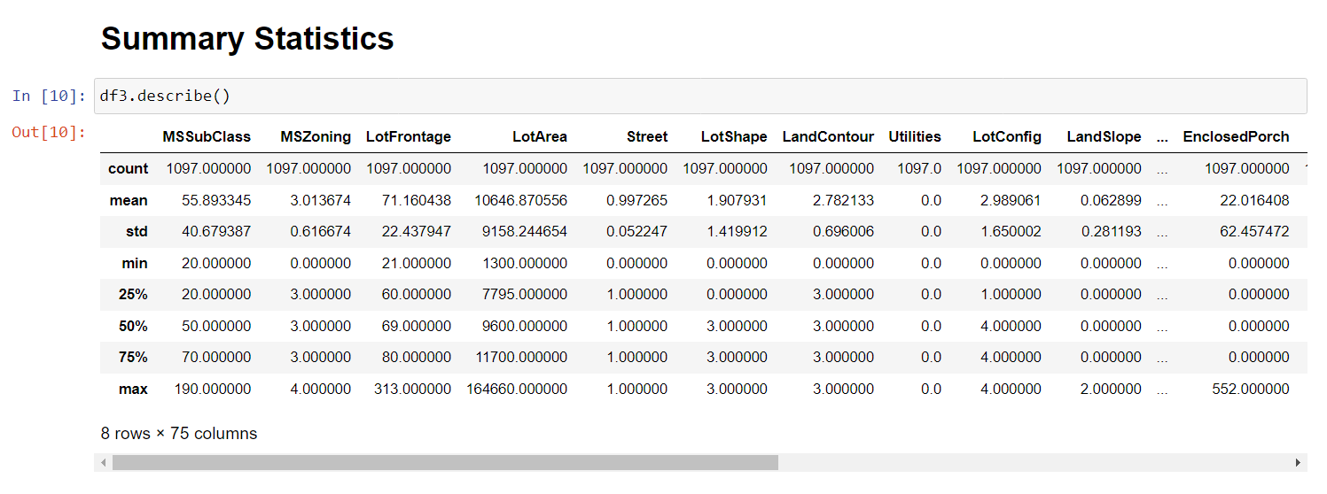
Statistics

Slide 11
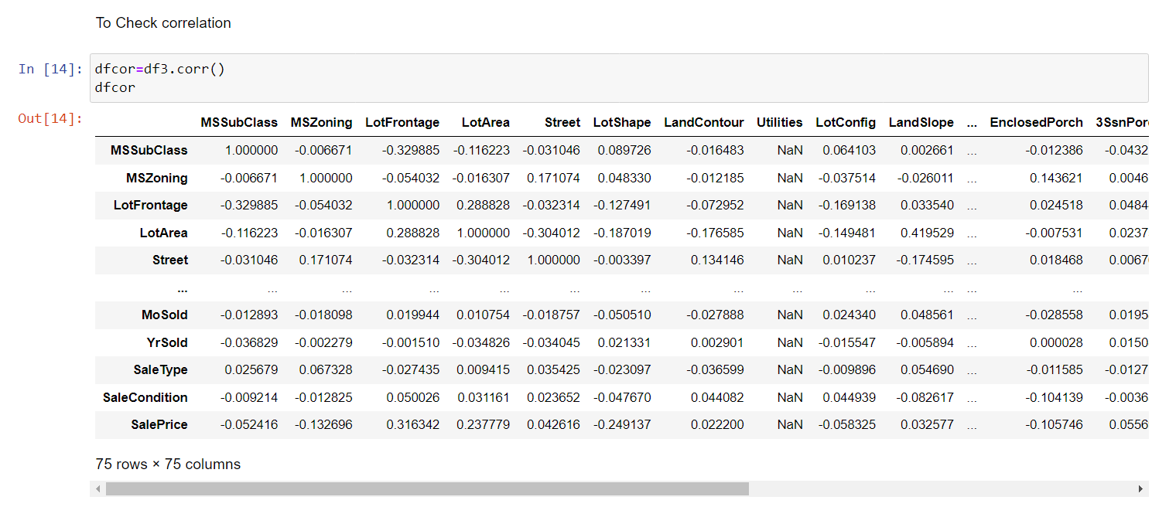
To Check correlation

Slide 12
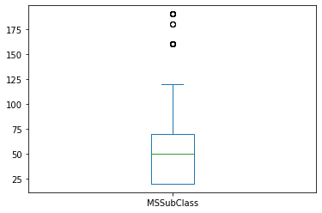
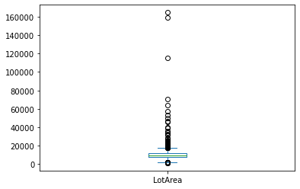
Univariate Analysis-Boxplot

Slide 13
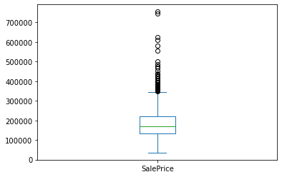
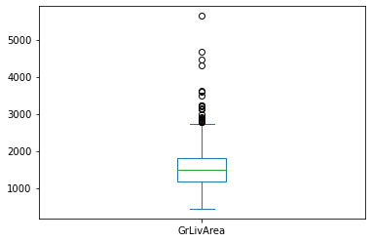
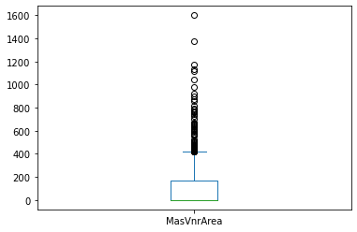
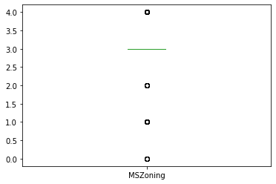

Slide 14
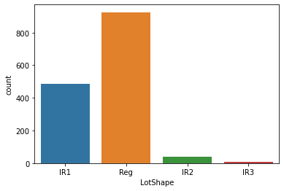
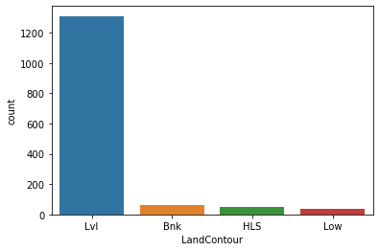
Count plot

Slide 15
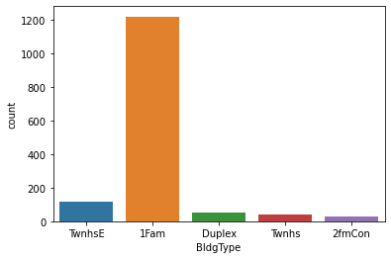
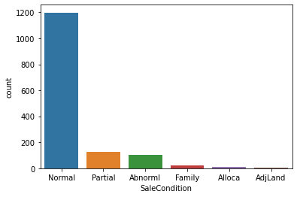
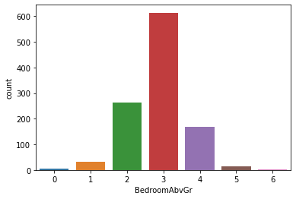
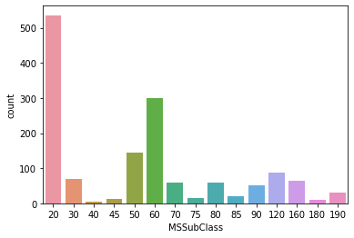

Slide 16
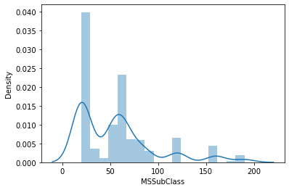
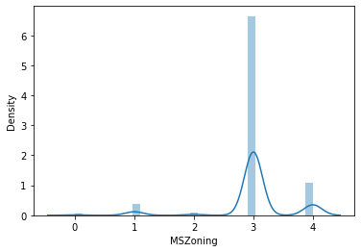
To check skewness

Slide 17
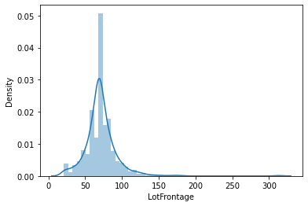
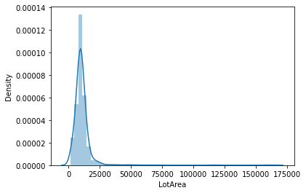
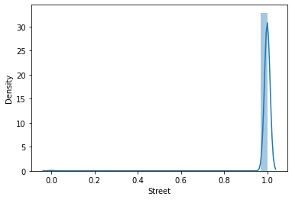
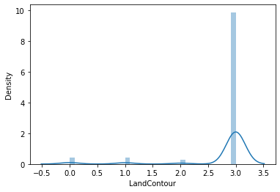

Slide 18
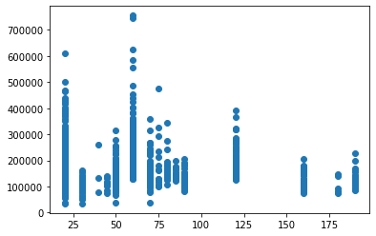
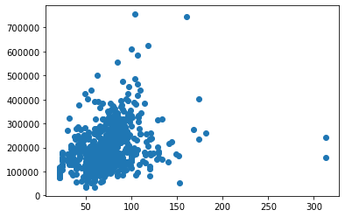
Bivariate Analysis

Slide 19
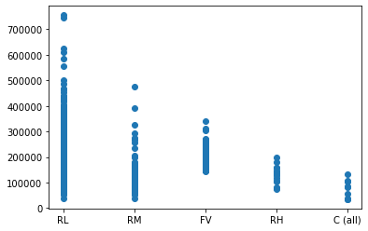
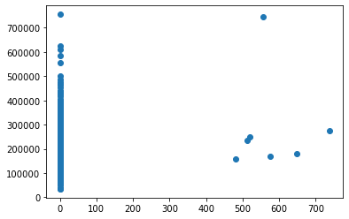
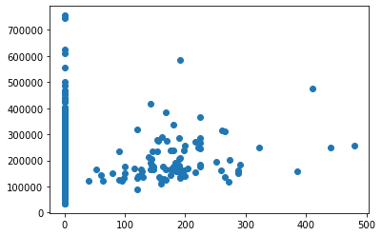
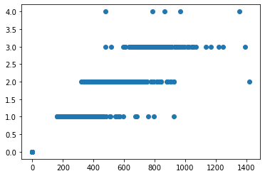

Slide 20
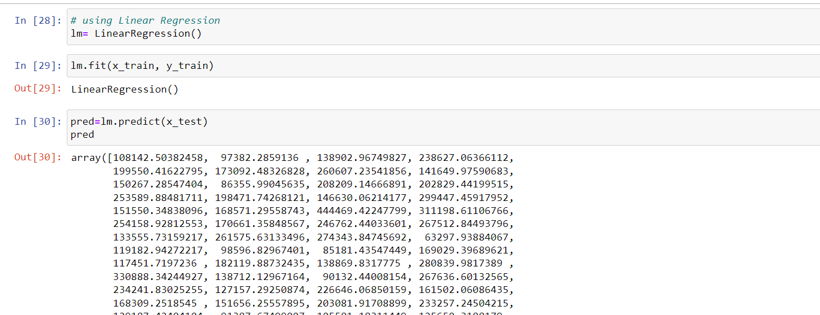
Training and testing of model

Slide 21
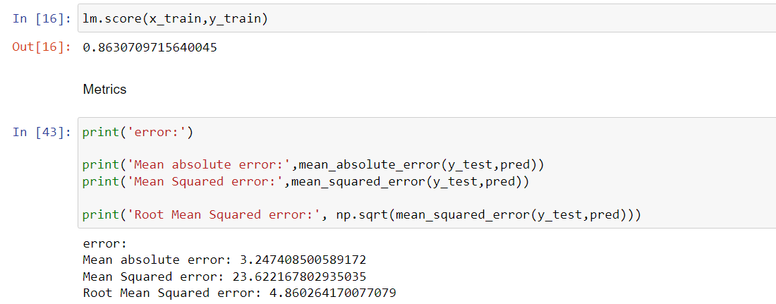
Conclusion
Our Aim is achieved as we have successfully ticked all our parameters as mentioned in our Aim Column. It is seen that the Linear Regression is the most effective model for our Dataset with 86% score.

